Slide 1
EC 544 Challenge 1 Building A Nest
Group 07
Xiangtian Yi, Shisheng Wang, Ye Xing, Yanlin Zhou

Slide 2
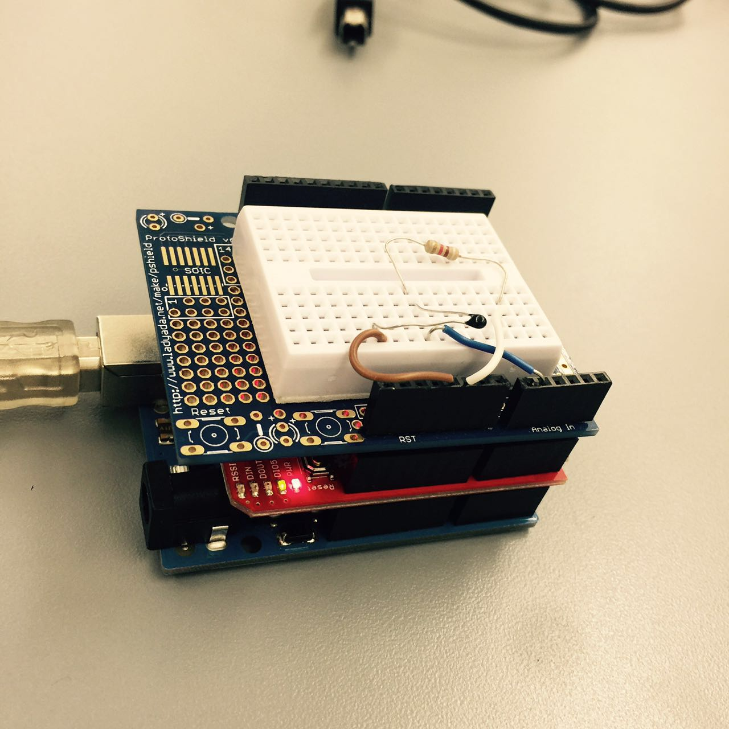
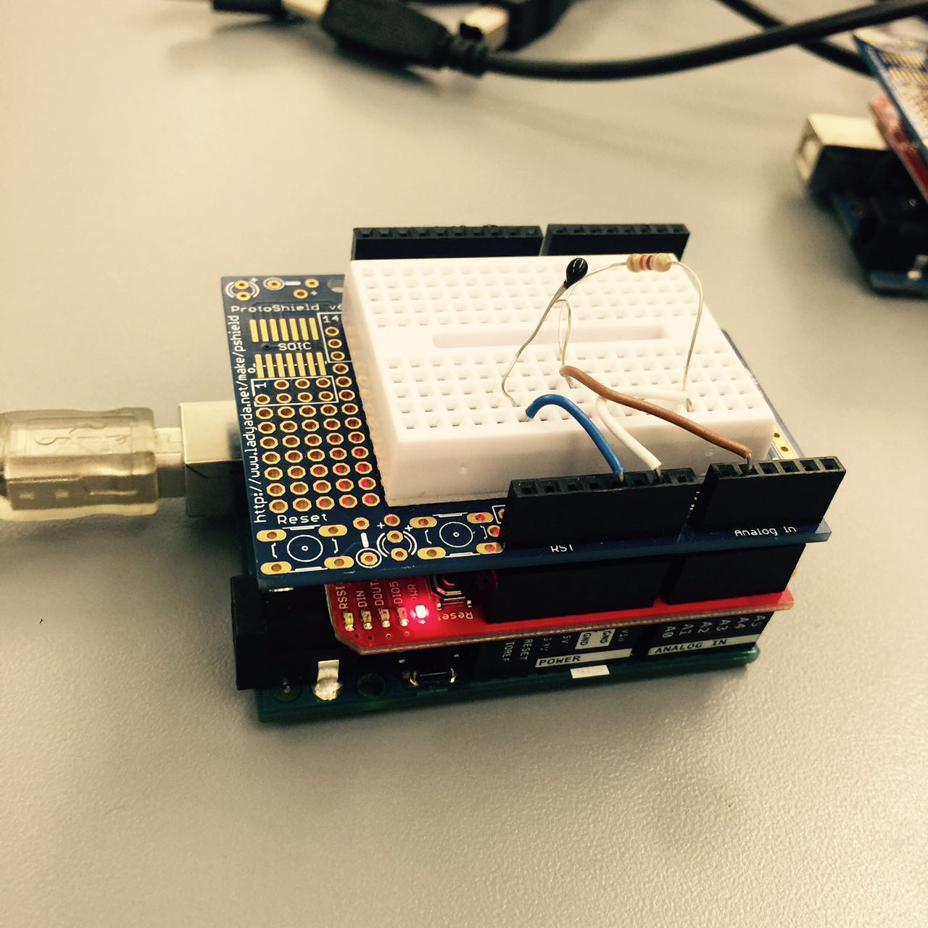
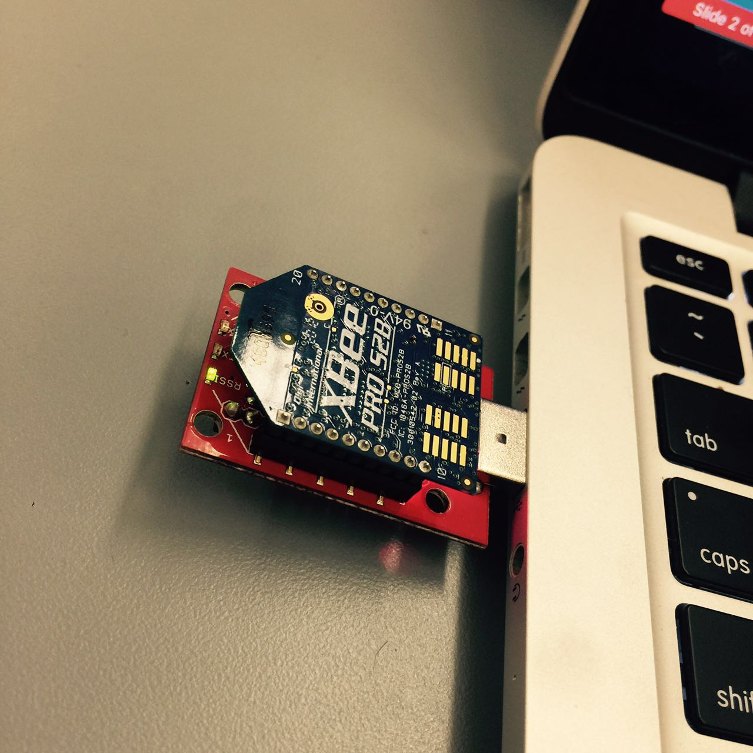
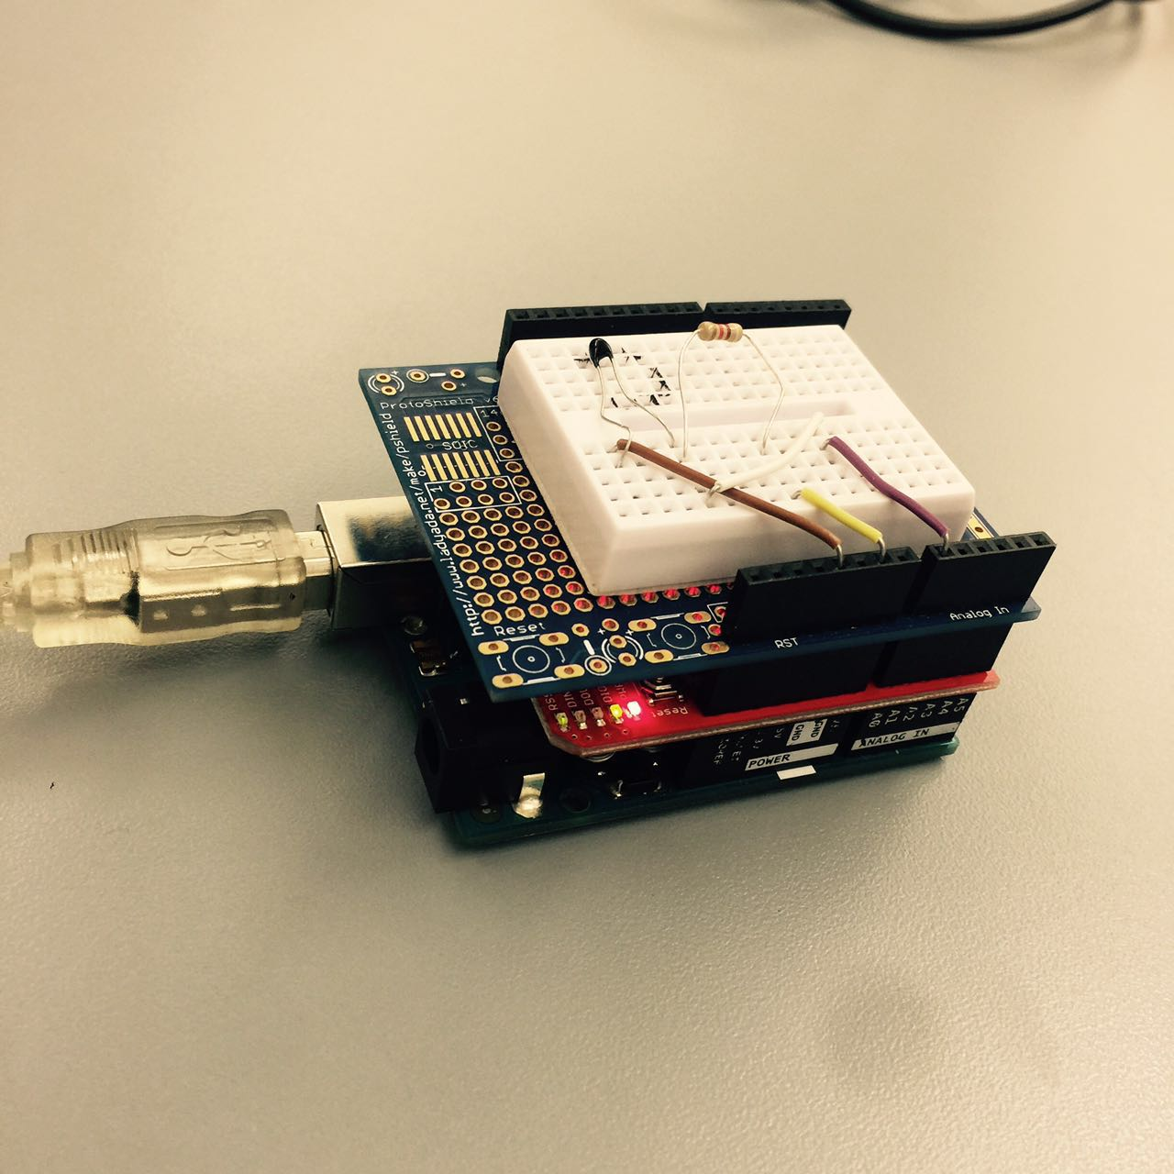
Design Concept
Coordinator:
Calculating the average of 3 temperatures from 3 sensors
Router 2
Router 1
Every sensor sends temperature every 2 second. And the coordinator would obtain the average temperature immediately.
Router 3

Slide 3
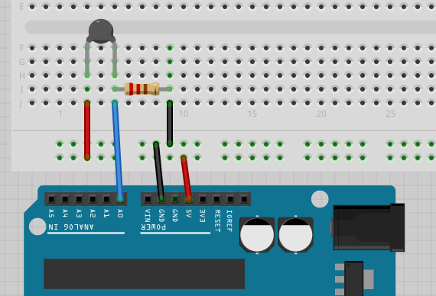
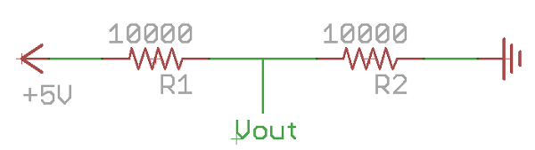
Voltage Divider Circuit
Sample Breadboard Wiring
Ref: https://computers.tutsplus.com/tutorials/how-to-read-temperatures-with-arduino--mac-53714

Slide 4
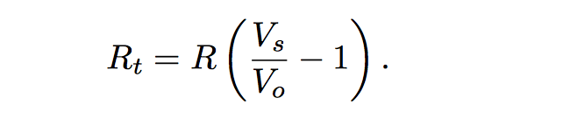
(1) Computing Thermistor Resistance
(2) Steinhart-Hart Equation
Ref: https://en.wikipedia.org/wiki/Steinhart%E2%80%93Hart_equation
where R = 10kohm
T = Temperature in Celsius
C1= 0.001129148
C2 = 0.000234125
C3 = 8.76741E-08

Slide 5
Challenges Encountered and Resolved
The malfunction of some analog ports led to errors. Serial monitor presented unexpected result.
Different baud rate led to error.
Cannot find the port of 3rd Party Arduino Board.
Code Optimization to improve quality and efficiency

